Slide 1
Central Dogma Theory and Kinetic Models

Slide 2
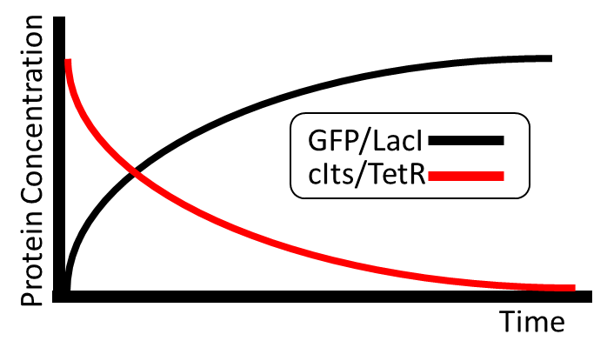
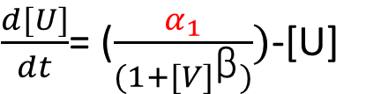
Overview
Central Dogma of Biology
DNA
RNA
PROTEIN
Kinetic Models
A
B
$\frac{d[U]}{dt}$= ($\frac{α_{1}}{(1+{[V]}^{\text{β}})})$-[U]
Computational Analysis of ODEs

Slide 3

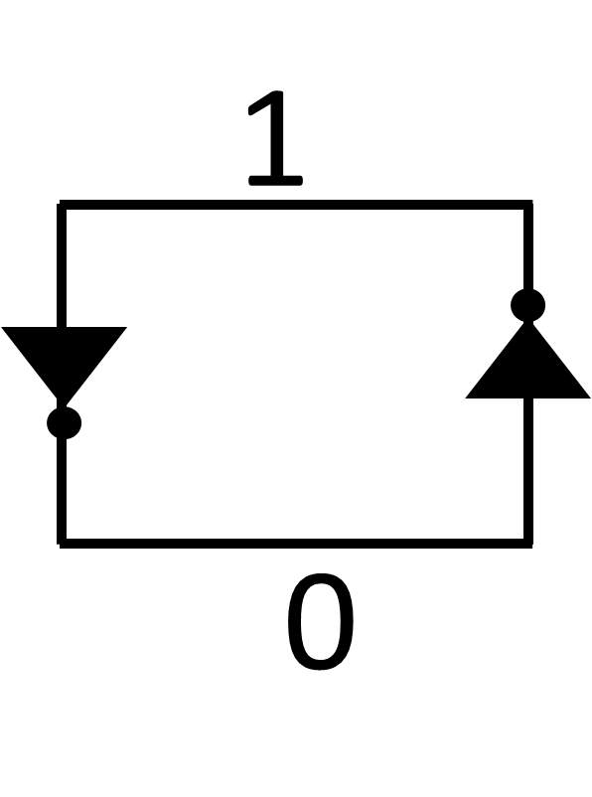
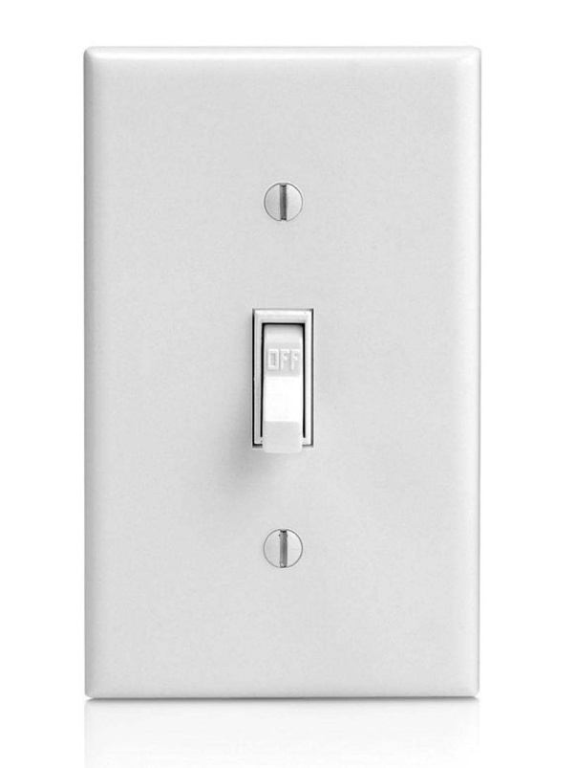
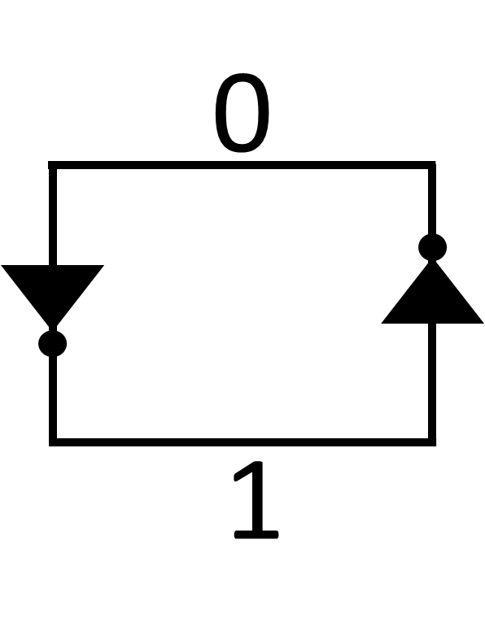
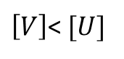
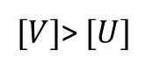
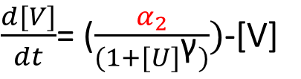
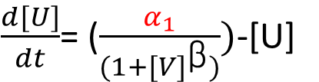
How Modeling is used
Experimental Implementation
$\left[V\right]$< $[U]$
Genetic Circuit Design
Mathematical Modeling
$\frac{d[U]}{dt}$= ($\frac{α_{1}}{(1+{[V]}^{\text{β}})})$-[U]
$\frac{d[V]}{dt}$= ($\frac{α_{2}}{(1+{[U]}^{\text{γ}})})$-[V]
$[V]$> $[U]$
Notes:
This is an example of the engineering design cycle.

Slide 4
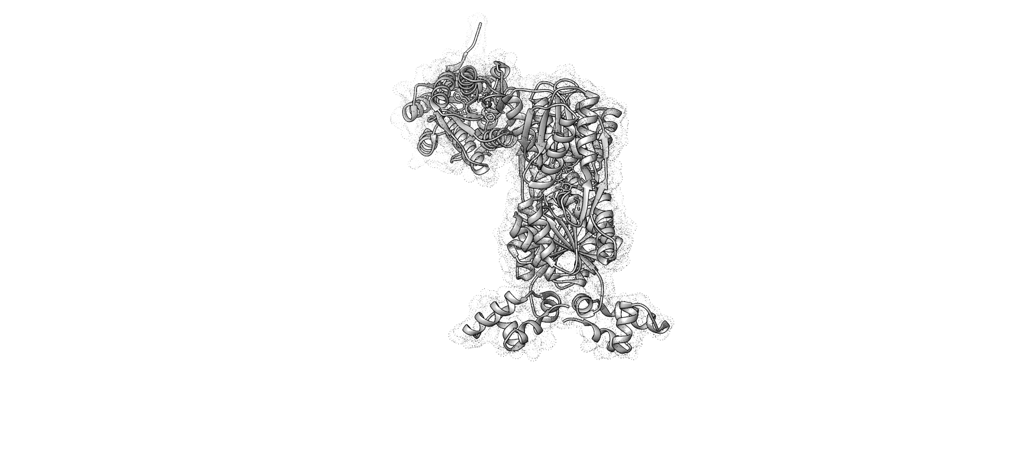
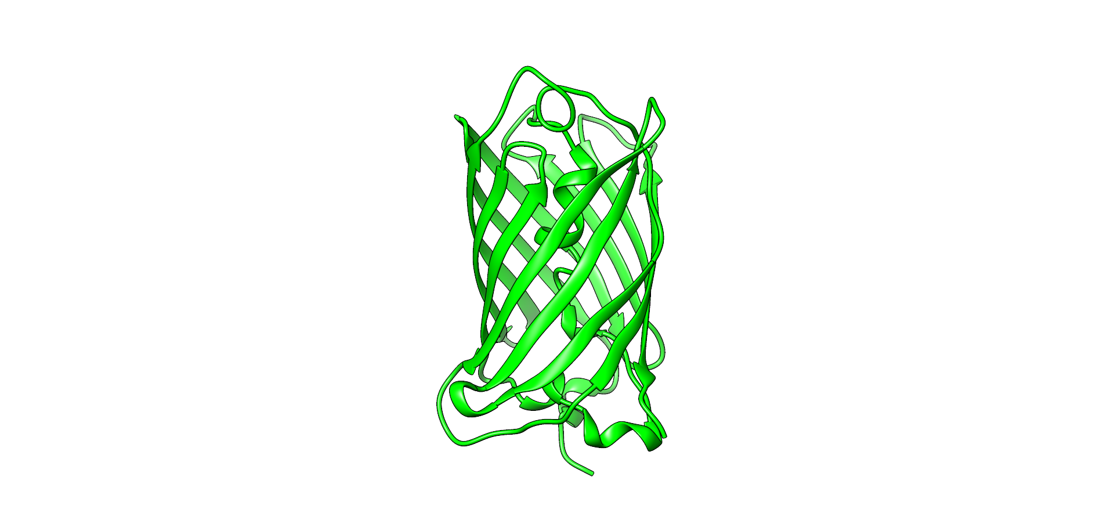
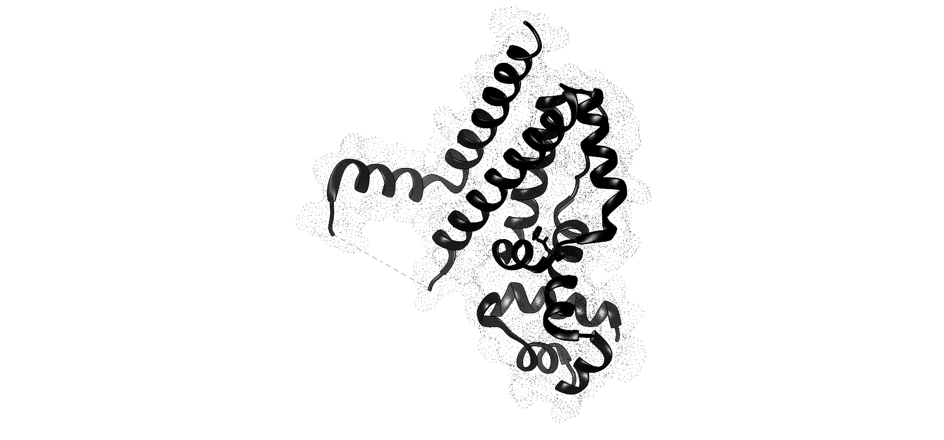
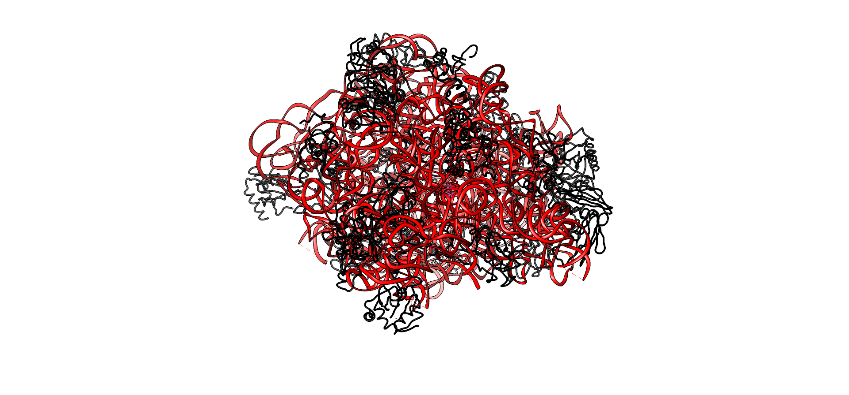
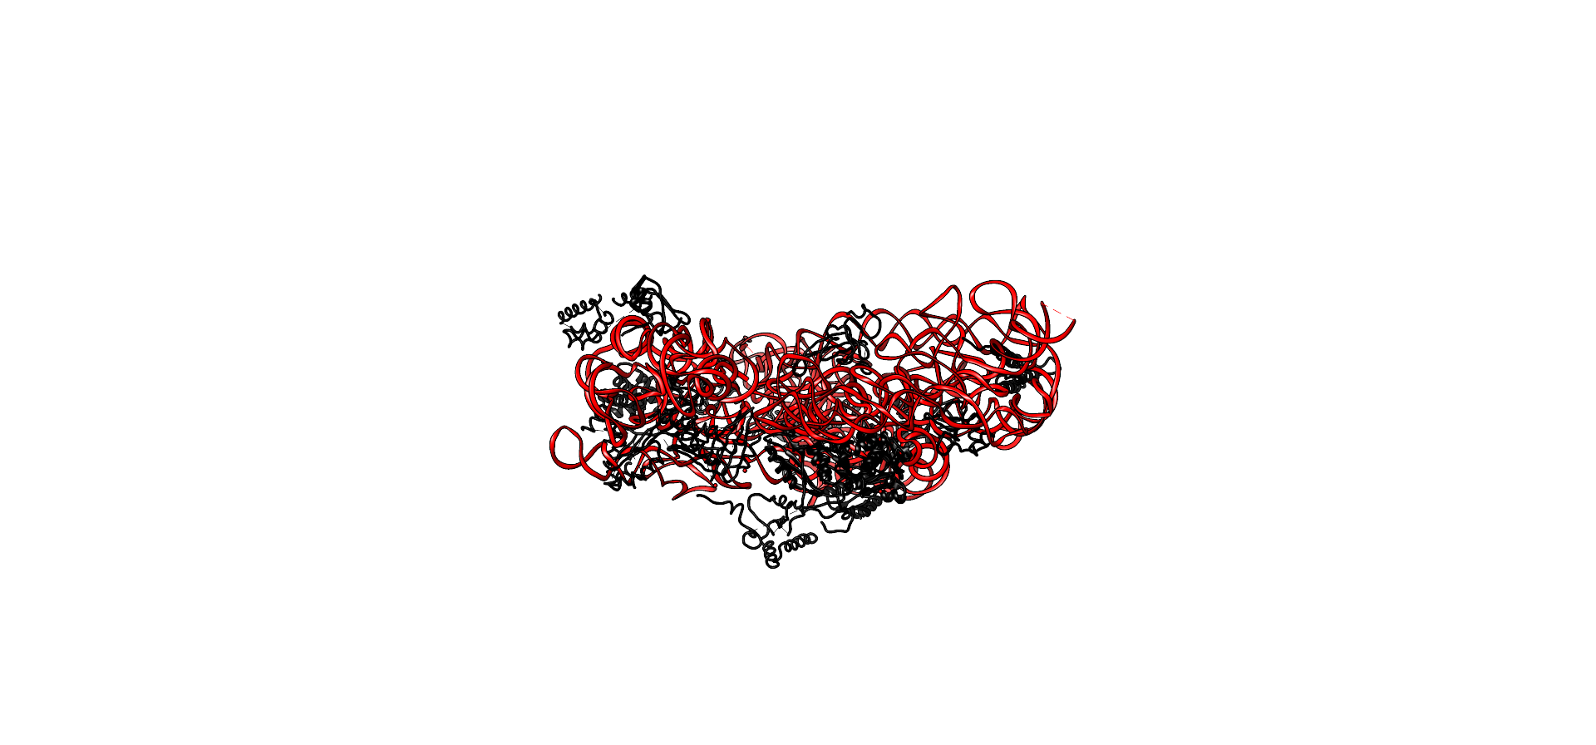
Central Dogma of Biology
DNA
RNA
PROTEIN
PROTEIN
PROTEIN
PROTEIN
TetR
ribosome
gfpmut3
lacI

Slide 5
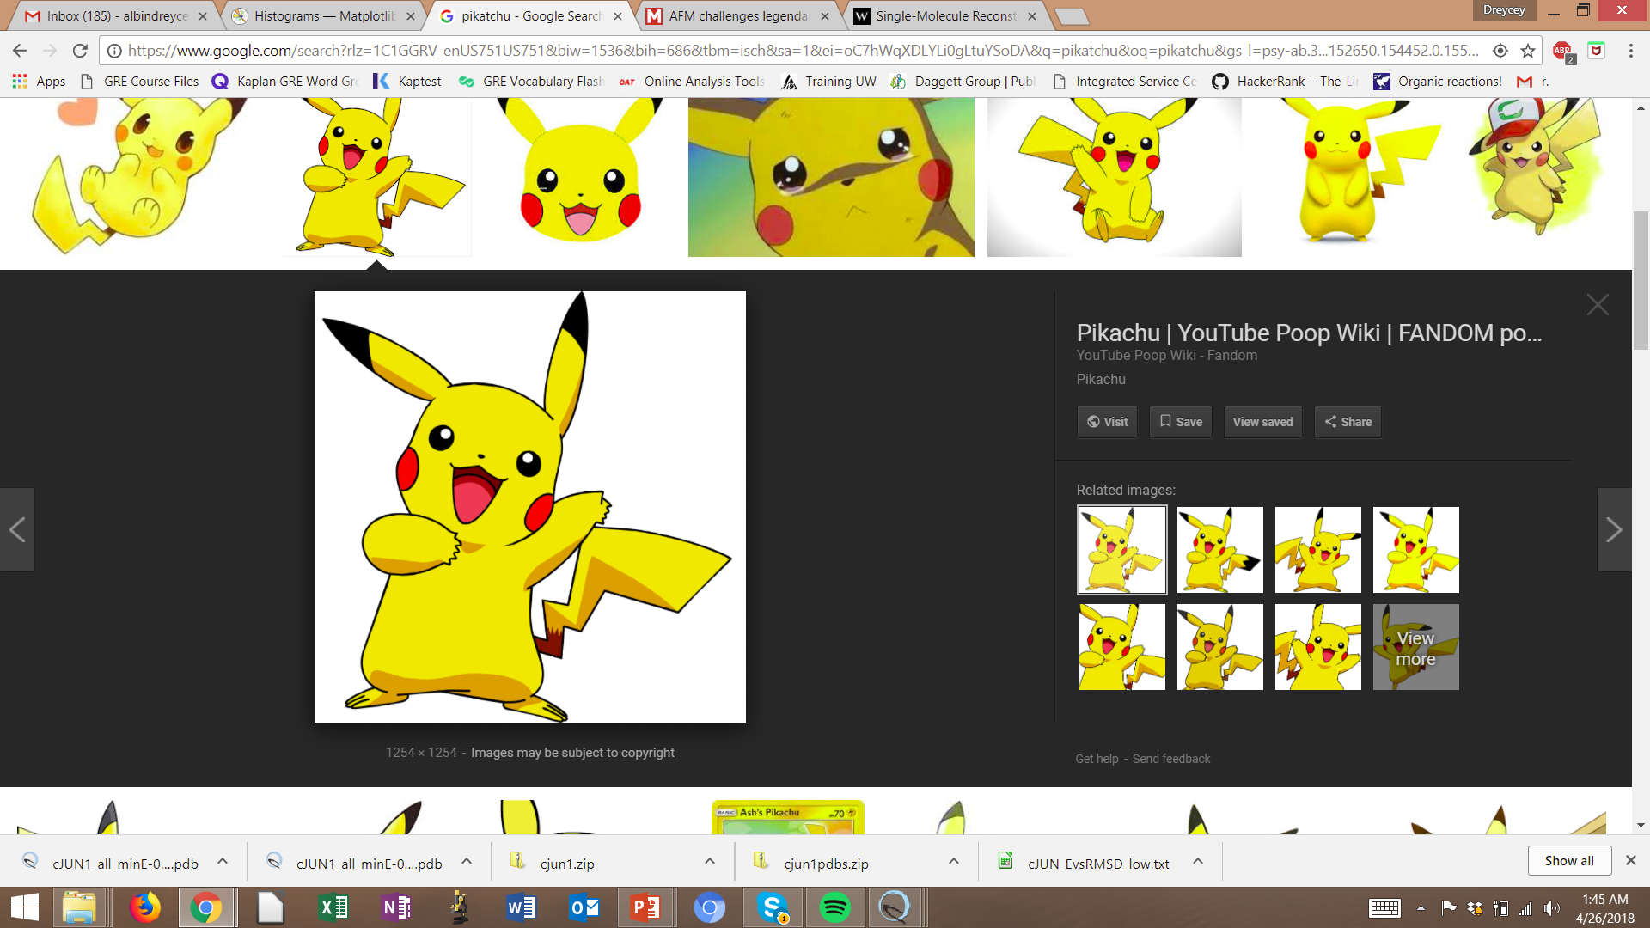
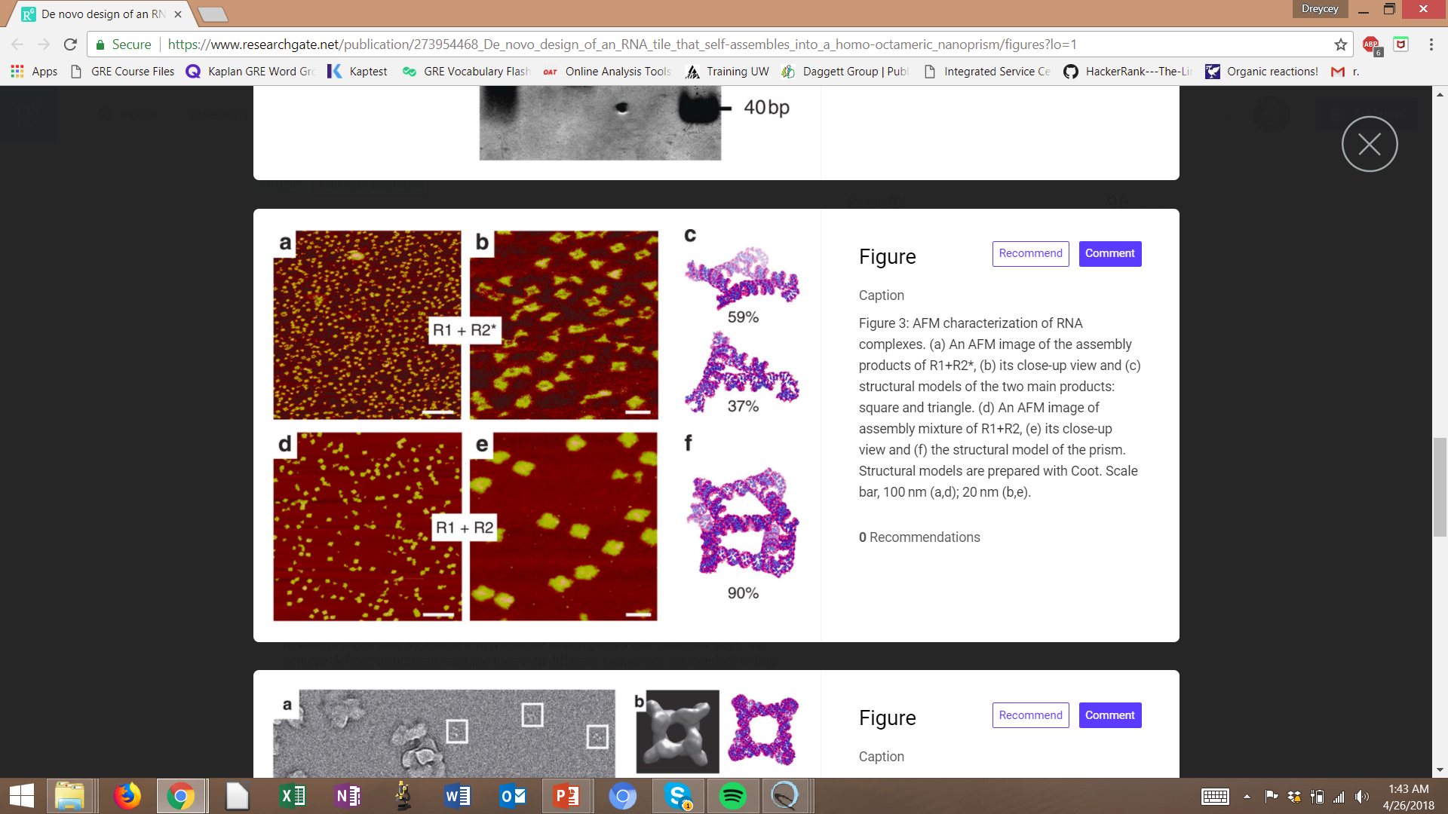
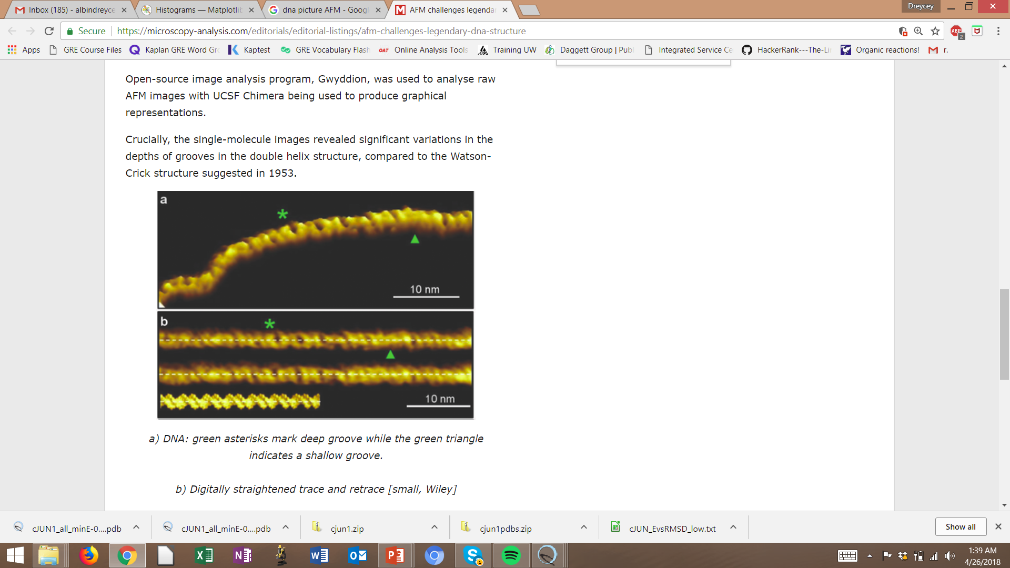
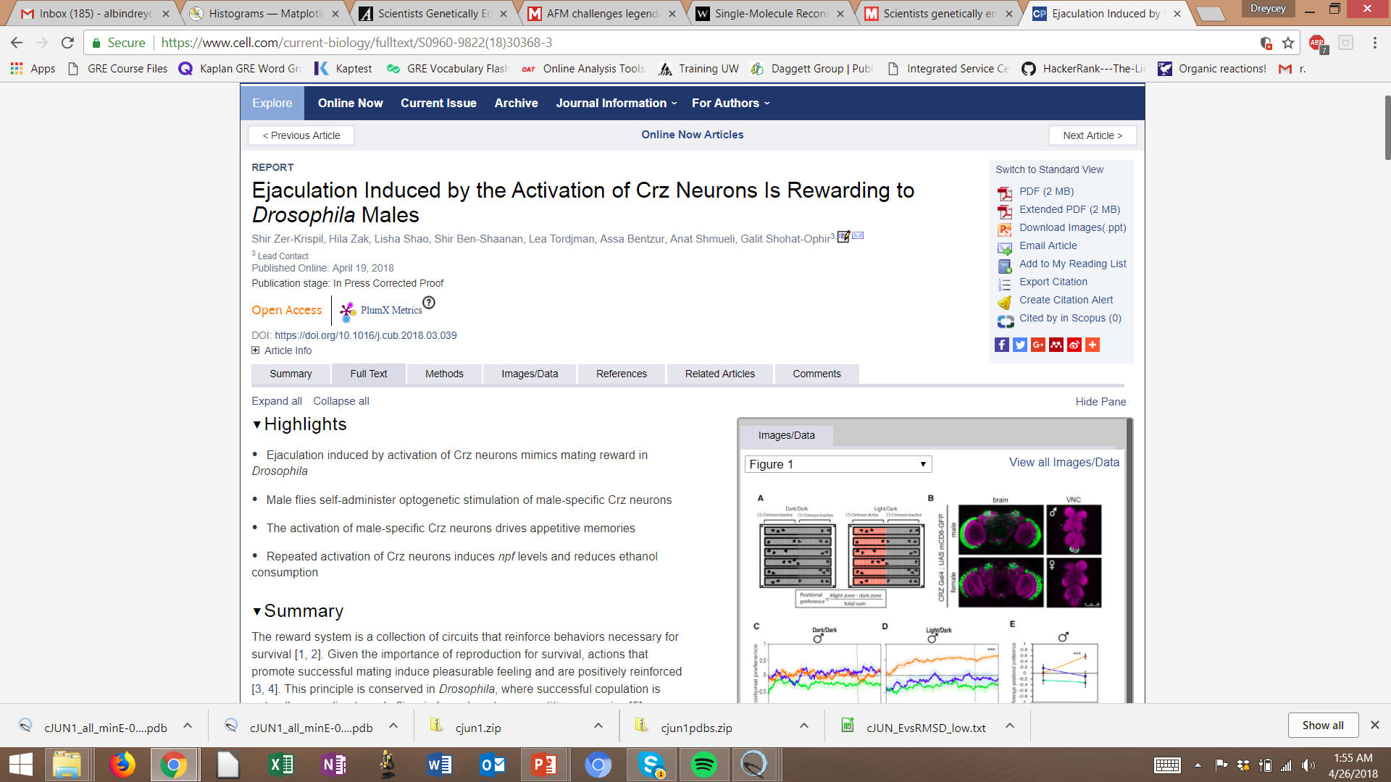

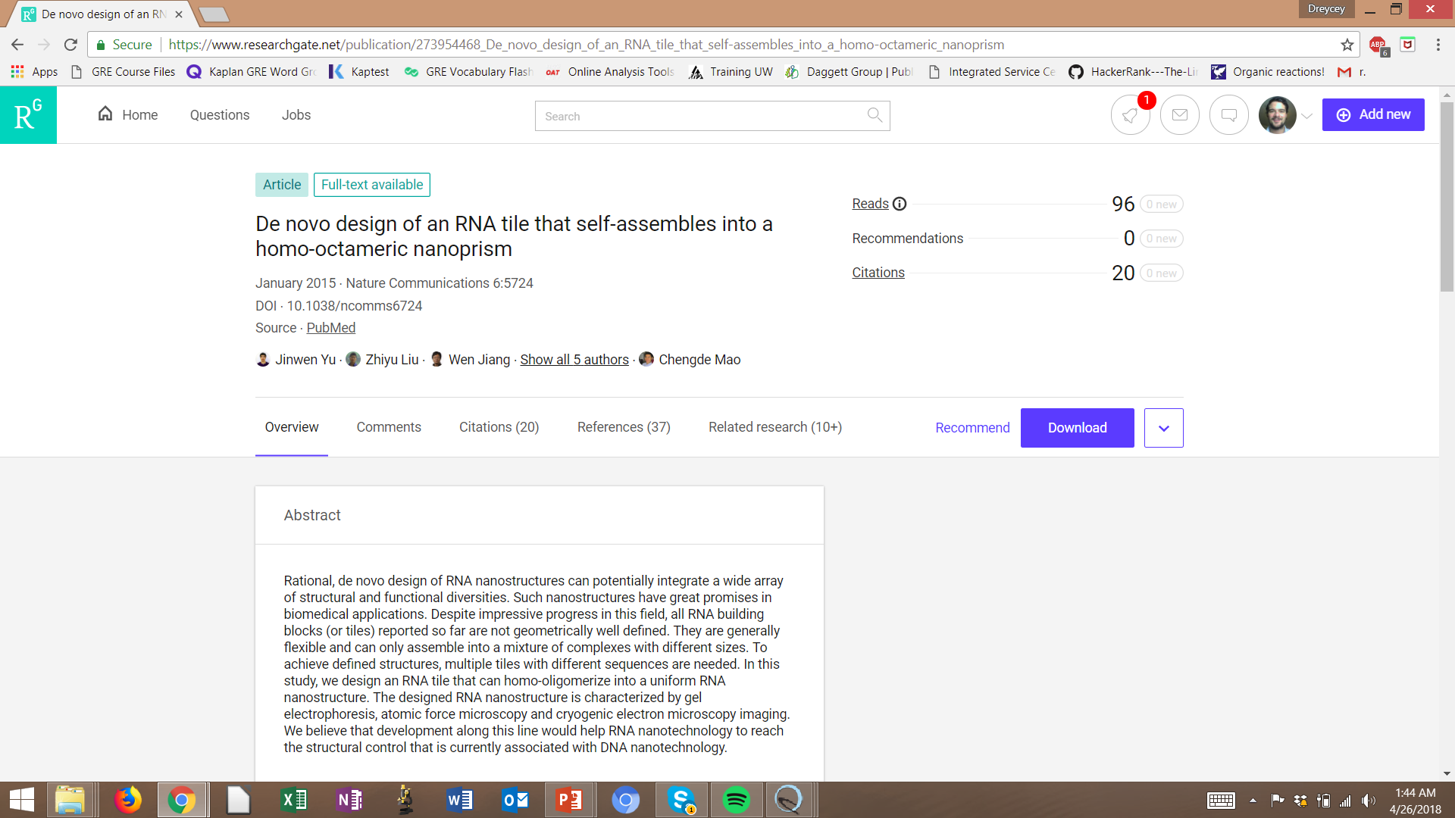
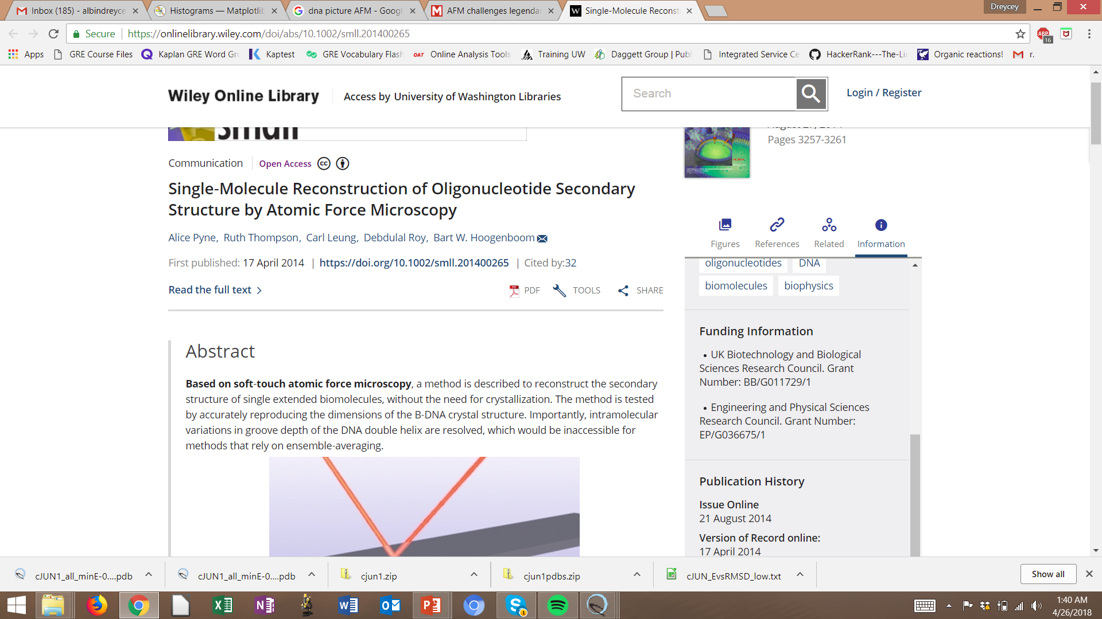
Central Dogma of Biology
DNA
RNA
PROTEIN

Slide 6
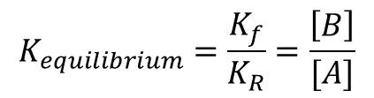
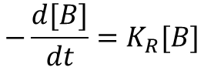
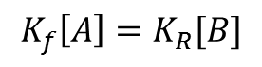
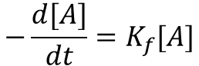
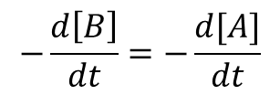
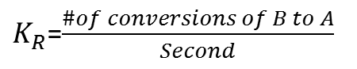
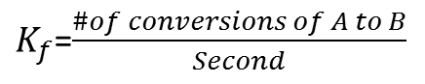
Kinetic Models: Mass Action
Kf
A
B
$$−\frac{d[A]}{dt}=K_{f}[A]$$
$K_{f}$=$\frac{\#of conversions of A to B}{Second}$
KR
$$−\frac{d[B]}{dt}=K_{R}[B]$$
$K_{R}$=$\frac{\#of conversions of B to A}{Second}$
At Equilibrium
$$−\frac{d\left[B\right]}{dt}=−\frac{d[A]}{dt}$$
$$K_{equilibrium}=\frac{K_{f}}{K_{R}}=\frac{\left[B\right]}{[A]}$$
$$K_{f}\left[A\right]=K_{R}[B]$$

Slide 7
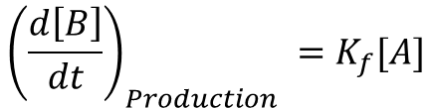
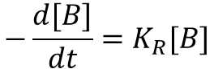
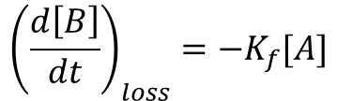
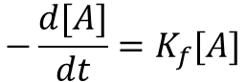
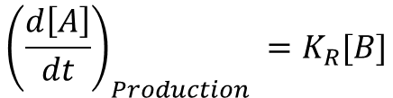
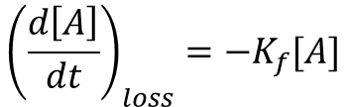
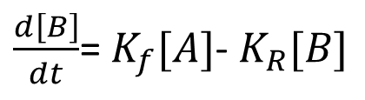
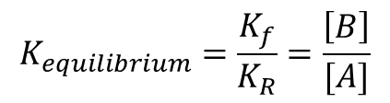
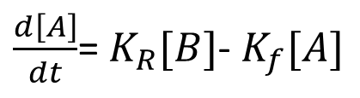
Kinetic Models: Basic Example
Kf
A
B
KR
$$K_{equilibrium}=\frac{K_{f}}{K_{R}}=\frac{\left[B\right]}{[A]}$$
$$−\frac{d[A]}{dt}=K_{f}[A]$$
$$−\frac{d[B]}{dt}=K_{R}[B]$$
Production
Loss
$${\left(\frac{d\left[A\right]}{dt}\right)}_{loss}={−K}_{f}[A]$$
$${\left(\frac{d\left[B\right]}{dt}\right)}_{loss}={−K}_{f}[A]$$
$\frac{d\left[A\right]}{dt}$= $K_{R}[B]$- $K_{f}[A]$
$\frac{d\left[B\right]}{dt}$= $K_{f}[A]$- $K_{R}[B]$
$${\left(\frac{d\left[A\right]}{dt}\right)}_{Production} =K_{R}[B]$$
$${\left(\frac{d\left[B\right]}{dt}\right)}_{Production} =K_{f}[A]$$

Slide 8
Review of
Construction of a genetic toggle switch in Escherichia coli
Timothy S. Gardner, Charles R. Cantor & James J. Collins

Slide 9
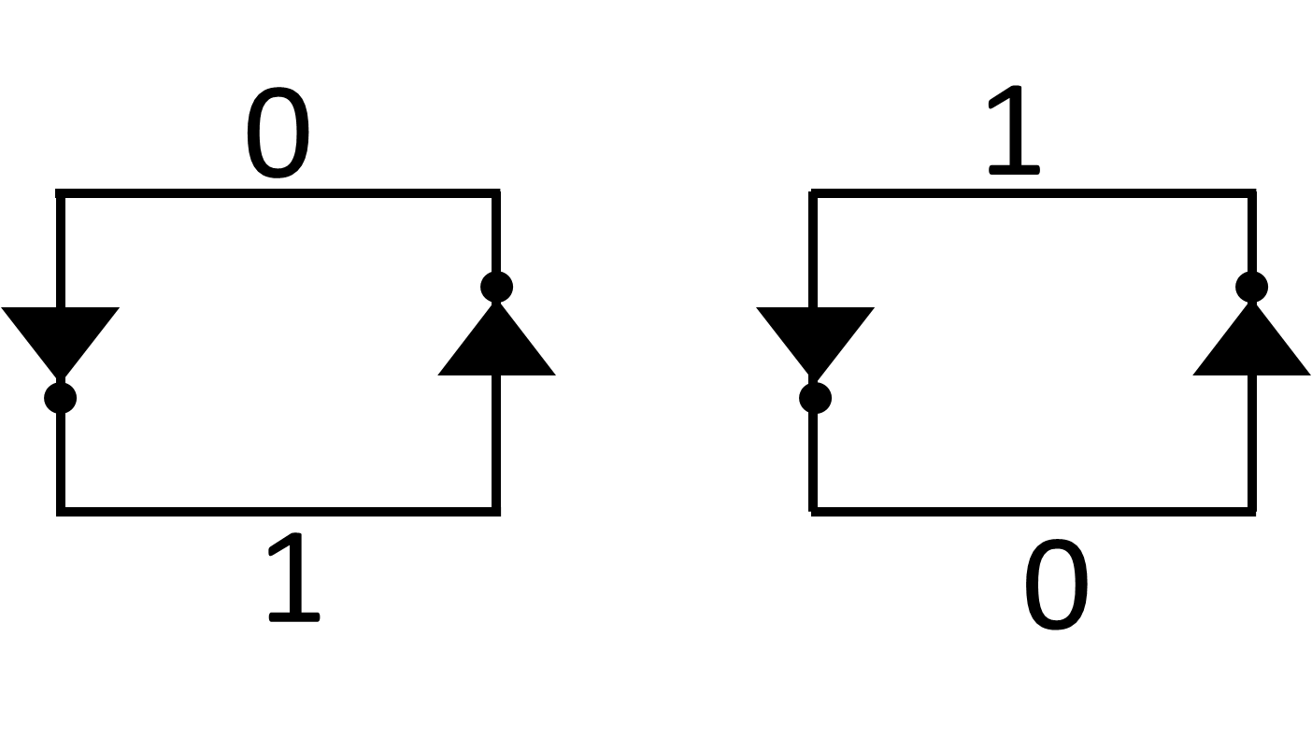
Memory Cells
A memory cell saves a 1 bit of memory.
Can be combined to represent higher order data
0
1
A
01000001
or
.
.
.
False
True
No
Yes
Z
01011010
Voltage
1
Voltage
1
0
0
Notes:
This 0 and 1 could represent true or
Iterative Design process

Slide 10
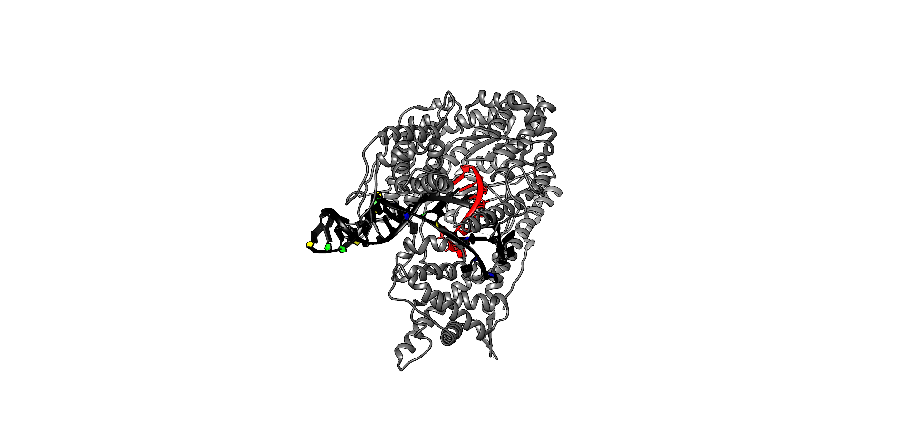
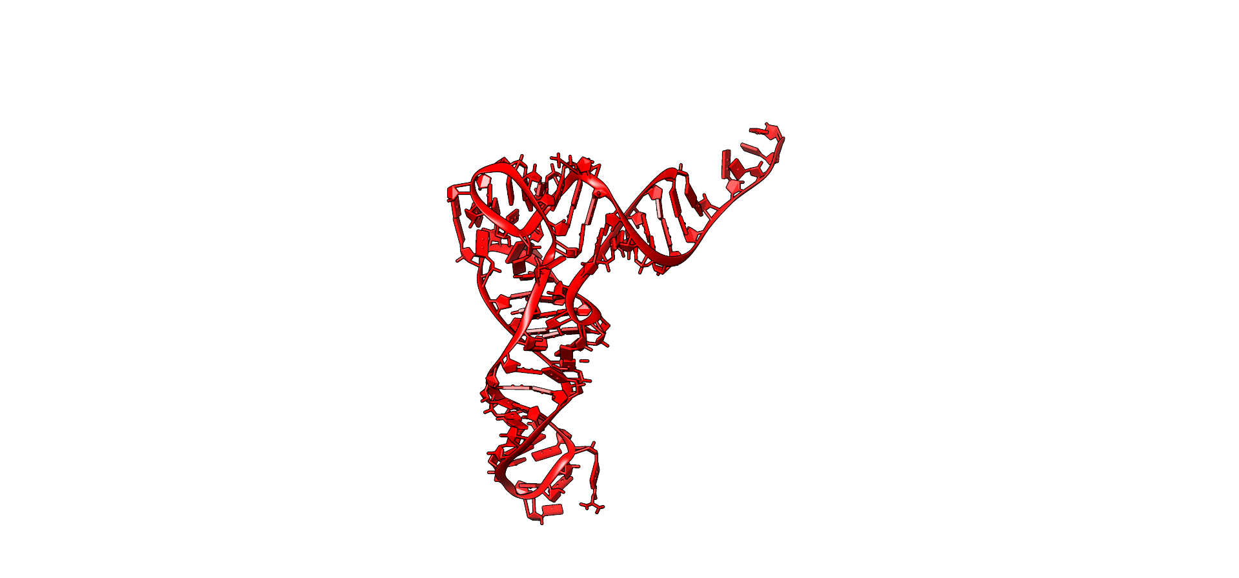
Design of Toggle Switch
PLs1con promoter
DNA
Repressor X
terminator
OR
terminator
GFP
RBS1
Rbs B
LacI
Rbs E
PLtetO-1 promoter
Ptrc-2 promoter
(RNAP) (1msw )
(RNAP) (1msw )
Transcription
Transcription
RNA
mRNA- TetR
mRNA-GFP/lac repressor
ribosome
Translation
Translation
OR
protein
TetR
cIts
lacI
gfpmut3
Structures sizes are not scaled the same**
Notes:
cITS is heat inducible
zGFP is cloned as a second cistron

Slide 11
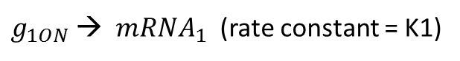
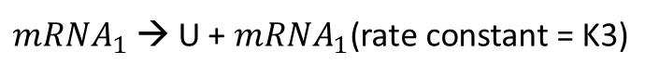
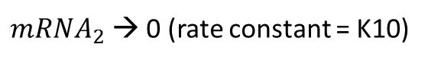
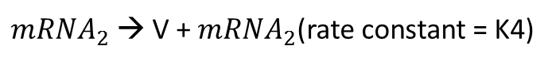
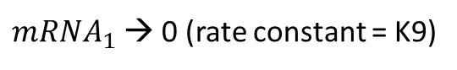
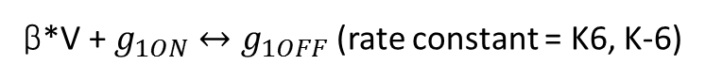
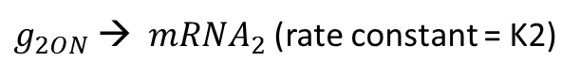
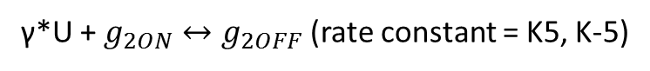
Kinetic Models: Genetic Toggle Switch
BIOLOGICAL DESCRIPTION
MATHEMATICAL DESCRIPTION
Transcription: DNA to RNA
Transcription: DNA to RNA
$g_{1ON}$→${ mRNA}_{1}$ (rate constant = K1)
$g_{2ON}$→${ mRNA}_{2}$ (rate constant = K2)
Translation: RNA to Protein
Translation: RNA to Protein
${mRNA}_{1}$ → U + ${mRNA}_{1}\text{(}\text{rate} \text{constant}\text{ = }\text{K}\text{3}\text{)}$
${mRNA}_{2}$ → V + ${mRNA}_{2}\text{(}\text{rate} \text{constant}\text{ = }\text{K}\text{4}\text{)}$
Macromolecular Degradation
Macromolecular Degradation
ΔTime
U → 0 (rate constant = K7)
V → 0 (rate constant = K8)
${mRNA}_{1}$ → 0 (rate constant = K9)
ΔTime
${mRNA}_{2}$ → 0 (rate constant = K10)
Circuit Design: Gene Repression
Circuit Design: Gene Repression
γ*U + $g_{2ON}↔g_{2OFF}$ (rate constant = K5, K-5)
β*V + $g_{1ON}↔g_{1OFF}$ (rate constant = K6, K-6)
Notes:
NOTE THAT U AND V REPRESENT COMPETING REPRESSORS, NOT GFP (well U should be equal to GFP).

Slide 12
Kinetic Models: Genetic Toggle Switch
MATHEMATICAL DESCRIPTION
Transcription: DNA to RNA
$g_{1ON}$→${ mRNA}_{1}$ (rate constant = K1)
$g_{2ON}$→${ mRNA}_{2}$ (rate constant = K2)
Translation: RNA to Protein
${mRNA}_{1}$ → U + ${mRNA}_{1}\text{(}\text{rate} \text{constant}\text{ = }\text{K}\text{3}\text{)}$
${mRNA}_{2}$ → V + ${mRNA}_{2}\text{(}\text{rate} \text{constant}\text{ = }\text{K}\text{4}\text{)}$
Macromolecular Degradation
U → 0 (rate constant = K7)
V → 0 (rate constant = K8)
${mRNA}_{1}$ → 0 (rate constant = K9)
${mRNA}_{2}$ → 0 (rate constant = K10)
Circuit Design: Gene Repression
γ*U + $g_{2ON}↔g_{2OFF}$ (rate constant = K5, K-5)
β*V + $g_{1ON}↔g_{1OFF}$ (rate constant = K6, K-6)
Notes:
NOTE THAT U AND V REPRESENT COMPETING REPRESSORS, NOT GFP (well U should be equal to GFP).

Slide 13
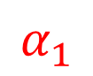
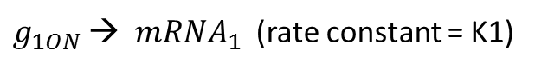
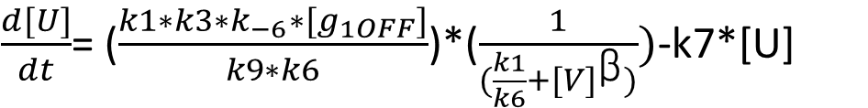













Modeling
MATHEMATICAL DESCRIPTION
Mass-Action Kinetics:
Transcription: DNA to RNA
$\frac{d[U]}{dt}$= ($\frac{k1∗k3∗k_{−6}∗[g_{1OFF}]}{k9∗k6}$)*($\frac{1}{(\frac{k1}{k6}+{[V]}^{\text{β}})})$-k7*[U]
$g_{1ON}$→${ mRNA}_{1}$ (rate constant = K1)
$g_{2ON}$→${ mRNA}_{2}$ (rate constant = K2)
$$α_{1}$$
$\frac{d[U]}{dt}$= ($\frac{α_{1}}{(\frac{k1}{k6}+{[V]}^{\text{β}})})$-k7*[U]
Translation: RNA to Protein
${mRNA}_{1}$ → U + ${mRNA}_{1}\text{(}\text{rate} \text{constant}\text{ = }\text{K}\text{3}\text{)}$
${mRNA}_{2}$ → V + ${mRNA}_{2}\text{(}\text{rate} \text{constant}\text{ = }\text{K}\text{4}\text{)}$
$\frac{d[U]}{dt}$= ($\frac{α_{1}}{(1+{[V]}^{\text{β}})})$-[U]
Macromolecular Degradation
U → 0 (rate constant = K7)
V → 0 (rate constant = K8)
$\frac{d[V]}{dt}$= ($\frac{k4∗k2∗k_{−5}∗[g_{2OFF}]}{k10∗k5}$)*($\frac{1}{(\frac{k2}{k5}+{[U]}^{\text{γ}})})$-k8*[V]
${mRNA}_{1}$ → 0 (rate constant = K9)
${mRNA}_{2}$ → 0 (rate constant = K10)
$$α_{2}$$
$\frac{d[V]}{dt}$= ($\frac{α_{2}}{(\frac{k2}{k5}+{[U]}^{\text{γ}})})$-k8*[V]
Circuit Design: Gene Repression
γ*U + $g_{2ON}↔g_{2OFF}$ (rate constant = K5, K-5)
$\frac{d[V]}{dt}$= ($\frac{α_{2}}{(1+{[U]}^{\text{γ}})})$-[V]
β*V + $g_{1ON}↔g_{1OFF}$ (rate constant = K6, K-6)
Notes:
Green= to make it dimensionless since it is used qualitatively
First term- coop repression of constative promoters.
Second term- decay

Slide 14
Analysis
Stable System
Unstable System
Time = 0 s
Time = Δt
Time = 0 s
Time = Δt
ΔTime
ΔTime
Notes:
Transitioning, now these can be used to model spects of the genetic switch, like stability..

Slide 15

Analysis
Stable System
Unstable System
Time = 0 s
Time = Δt
Time = 0 s
Time = Δt
ΔTime
ΔTime
Notes:
We want something stable, unlike my memory freshman year when id cram for a test.

Slide 16













Analysis
$$y_{1}$$
$$y_{2}$$
$$y_{2}$$
$$y_{2}$$
$${y=log(α}_{1})$$
$Β$= $\text{γ}$=2
$y_{1}$ is Stable
$Β$= $\text{γ}$=2
$y_{2}$ $y_{1}$ are Stable
$y_{2}$ is Stable
DESMOS!!
$${log(α}_{2})=x$$
Notes:
We want something stable, unlike my memory freshman year when id cram for a test.

Slide 17




Computational Analysis of ODEs
RNA
PROTEIN
gfpmut3

Slide 18






INDUCERS
Repressor:
Inducer:
If Induced:
lacI
IPTG
High State
TetR
aTc
Low State
cIts
Temperature
Low State

Slide 19




Computational Analysis of ODEs

Slide 20



Closing Remarks
“The work on restriction nucleases not only permits us easily to construct recombinant DNA molecules and to analyze individual genes, but also has led us into the new era of synthetic biology where not only existing genes are described and analyzed but also new gene arrangements can be constructed and evaluated.”
Wacław Szybalski, 1973

